Slide 1
CS4101 嵌入式系統概論
Low-Power Optimization
金仲達教授
國立清華大學資訊工程學系
(Materials from MSP430 Microcontroller Basics, John H. Davies, Newnes, 2008)

Slide 2
Introduction
Why low power?
  Portable and mobile devices are getting popular, which have limited power sources, e.g., battery
  Energy conservation for our planet
  Power generates heat → low carbon
Power optimization becomes a new dimension in system design, besides performance and cost
MSP430 provides many features for low-power operations, which will be discussed next

Slide 3
Outline
Introduction to low-power optimizations
Low-power design in MSP430

Slide 4

Energy and Power
Energy: ability to do work
  Most important in battery-powered systems
Power: energy per unit time
  Important even in wall-plug systems---power becomes heat
Power draw
increases with…
  Vcc
  Clock speed
  Temperature

Slide 5
Efforts for Low Power
Device/transistor level
  Development of low power devices
  Reducing power supply voltage
  Reducing threshold voltage
Circuit level
  Clock gating, frequency reduction, circuit turned off
  Asynchronous circuits
System level
  Compiler optimization for energy
  OS-directed power management
Application level

Slide 6
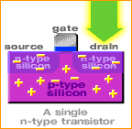
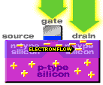
Transistor Level
Switching consumes power → dynamic power
  Switching slower, consume less power
Smaller sizes reduce power to operate

Slide 7
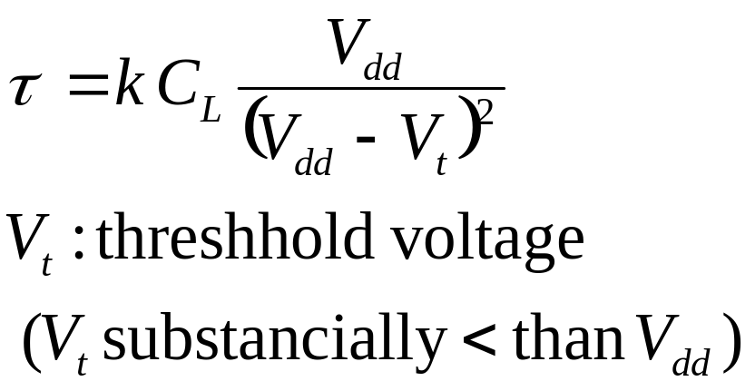
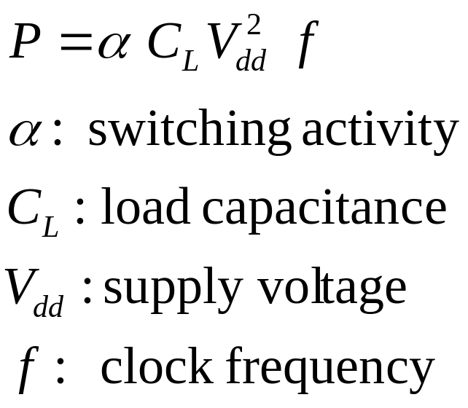
Circuit Level
Power consumption of CMOS
circuits (ignoring leakage):
Delay for CMOS circuits:
Decreasing V_{dd} reduces P quadratically, while the run-time of program is only linearly increased

Slide 8
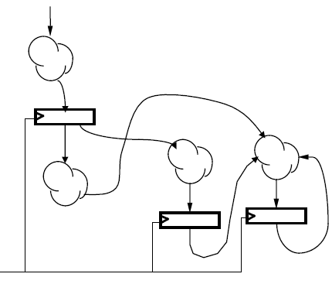

Circuit Level
Clock gating for synchronous sequential logic:
  Disable the clock so that flip-flops will hold their states forever and the whole circuit will not switch
  → no dynamic power consumed
Still need static power to hold the states
clock

Slide 9
System Level: Compiler
Energy-aware code scheduling
Energy-aware instruction selection
Operator strength reduction: e.g. replace * by + and <<
Minimize the bit width of loads and stores
Standard optimizations with energy as a cost function
R2:=a[0];
for i:= 1 to 10 do
begin
R1:= a[i];
C:= 2 * R1 + R2;
R2 := R1;
end;
E.g.: register pipelining:
for i:= 0 to 10 do
C:= 2 * a[i] + a[i-1];

Slide 10
System Level: Compiler
First-order optimization:
  high performance = low energy (some exceptions)
Optimize memory access patterns
Use registers efficiently
Identify and eliminate cache conflicts
Moderate loop unrolling eliminates some loop overhead instructions
Eliminate pipeline stalls (e.g., software pipeline)
Inlining procedures may help: reduces linkage, but may increase cache thrashing

Slide 11
System Level: OS
Idle base
  After idle for a period, switch system to sleep mode
Power-aware memory management
  Access data locally
  e.g. OS can determine points during execution of an application where memory banks would remain idle, so they can be transitioned to low power modes
Power-aware buffer cache
  Collect disk operations in a cache until the hard drive is running or has enough data

Slide 12
System Level: Cooperative I/O
Time
Idle
Idle
Idle
Idle
Idle
Standby
Idle
Time
Standby
Idle
Standby
Reduces power consumption by batching requests

Slide 13
Outline
Introduction to low-power optimizations
Low-power design in MSP430

Slide 14
General Strategies
Put the system in low-power modes and/or use low-power modules as much as possible
How?
  Provide clocks of different frequencies → frequency scaling
  Turn off clocks when no work to do → clock gating
  Use interrupts to wake up the CPU, return to sleep when done (another reason to use interrupts)
  Switched on peripherals only when needed
  Use low-power integrated peripheral modules in place of software, e.g., move data between modules

Slide 15
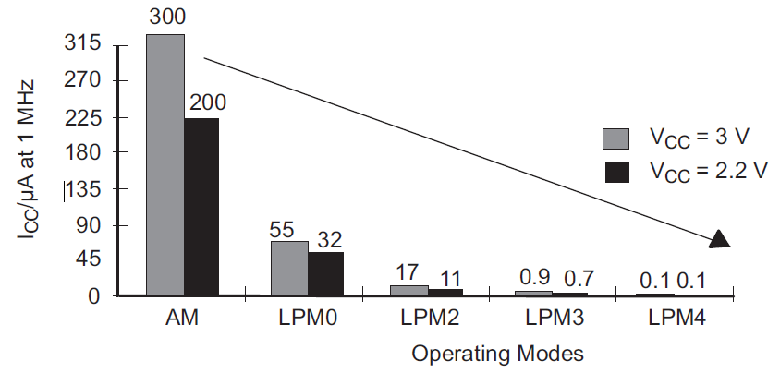
MSP430 Low-Power Modes
Mode | CPU and Clocks
Active | CPU active; all enabled clocks active
LPM0 | CPU, MCLK disabled; SMCLK, ACLK active
LPM1 | CPU, MCLK disabled; DCO disabled if not for SMCLK; ACLK active
LPM2 | CPU, MCLK, SMCLK, DCO disabled; ACLK active
LPM3 | CPU, MCLK, SMCLK, DCO disabled; ACLK active
LPM4 | CPU and all clocks disabled

Slide 16
MSP430 Low Power Modes
Active mode:
  MSP430 starts up in this mode, which must be used when the CPU is required, i.e., to run code
  An interrupt automatically switches MSP430 to active
  Current can be reduced by running at lowest supply voltage consistent with the frequency of MCLK, e.g. V_{CC} to 1.8V for f_{DCO} = 1MHz
LPM0:
  CPU and MCLK are disabled
  Used when CPU is not required but some modules require a fast clock from SMCLK and DCO

Slide 17
MSP430 Low Power Modes
LPM3:
  Only ACLK remains active
  Standard low-power mode when MSP430 must wake itself at regular intervals and needs a (slow) clock
  Also required if MSP430 must maintain a real-time clock
LPM4:
  CPU and all clocks are disabled
  MSP430 can be wakened only by an external signal, e.g., RST/NMI, also called RAM retention mode

Slide 18
Controlling Low Power Modes
Through four bits in status register (SR) in CPU
  SCG0 (System clock generator 0): when set, turns off DCO, if DCOCLK is not used for MCLK or SMCLK
  SCG1 (System clock generator 1): when set, turns off the SMCLK
  OSCOFF (Oscillator off): when set, turns off LFXT1 crystal oscillator, when LFXT1CLK is not use for MCLK or SMCLK
  CPUOFF (CPU off): when set, turns off the CPU
  All are clear in active mode

Slide 19
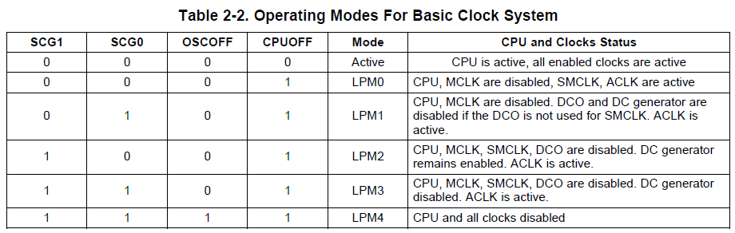
Controlling Low Power Modes
Status bits and low-power modes

Slide 20
Entering/Exiting Low-Power Modes
Interrupt wakes MSP430 from low-power modes:
Enter ISR:
  PC and SR are stored on the stack
  CPUOFF, SCG1, OSCOFF bits are automatically reset
  → entering active mode
  MCLK must be started so CPU can handle interrupt
Options for returning from ISR:
  Original SR is popped from the stack, restoring the previous operating mode
  SR bits stored on stack can be modified within ISR to return to a different mode when RETI is executed
All done in hardware

Slide 21
Sample Code (msp430g2xx3_ta_uart9600)
void main(void) { WDTCTL = WDTPW + WDTHOLD; // Stop watchdog timer DCOCTL = 0x00; // Set DCOCLK to 1MHz BCSCTL1 = CALBC1_1MHZ; DCOCTL = CALDCO_1MHZ; P1OUT = 0x00; // Initialize all GPIO P1SEL = UART_TXD + UART_RXD; // Use TXD/RXD pins P1DIR = 0xFF & ~UART_RXD; // Set pins to output __enable_interrupt(); for (;;) { // Wait for incoming character __bis_SR_register(LPM0_bits); // Echo received character TimerA_UART_tx(rxBuffer); } }

Slide 22
Sample Code (msp430g2xx3_ta_uart9600)
#pragma vector = TIMER0_A1_VECTOR __interrupt void Timer_A1_ISR(void) { static unsigned char rxBitCnt = 8; static unsigned char rxData = 0; ... TACCR1 += UART_TBIT; // Add Offset to CCRx if (TACCTL1 & CAP) { // On start bit edge TACCTL1 &= ~CAP; // Switch to compare mode TACCR1 += UART_TBIT_DIV_2; // To middle of D0 } else { // Get next data bit rxData >>= 1; if (TACCTL1 & SCCI) { // Get bit from latch rxData |= 0x80; } rxBitCnt--;

Slide 23
Sample Code (msp430g2xx3_ta_uart9600)
if (rxBitCnt == 0) { // All bits RXed? rxBuffer = rxData; // Store in global rxBitCnt = 8; // Re-load bit counter TACCTL1 |= CAP; // Switch to capture __bic_SR_register_on_exit(LPM0_bits); // Clear LPM0 bits from 0(SR) } }
What happens in the middle of receiving byte?
What happens at the end of receiving byte?

Slide 24
Issues to Discuss
Which saves more energy?
  Use a higher frequency to run a program faster so as to sleep longer
  Use a lower frequency to run a program to save power, but system may be active longer

